Slide 1



Trading Model for Cryptocurrency Trading
TEAM ID- 24KTJKHAP751341
01
Paramananda Bhaskar
02
Vishwajeet Singh Solanki
03
Akshat Ayush Modi
04
Datta Ksheeraj

Slide 2
Data Acquisition:
Data Preprocessing
Model Design
Overview
Backtesting
Risk Management
Optimisation

Slide 3






Our Approaches
LSTM
convLSTM
RNN

Slide 4



Data Acquisition
The dataset contains ten columns , namely , timestamp, open price, close price, high price, low price, volume, number of trades, Taker Buy Base Asset volume,
Taker Buy Quote Asset volume, Quote Asset Volume
in_sample_df: dataframe from 2018/01/01 till 2022/01/31
out_sample_1_df: dataframe from 2022/02/01 till 2022/12/31
out_sample_2_df: dataframe from 2023/01/01 till 2023/12/31
The in-sample check ratio we have implemented is 0.9 i.e 90 percent of in sample data is used for training the model and 10 percent is used for in-sample testing

Slide 5

Data Preprocessing
For our convenience in handling of data in more concise way we have converted data from being minute sampled to being hour sampled.
With regard to that conversion we have calculated every attribute for the new data using those given for the original data.
Normalization has also been done that involves scaling and centering input data to improve the training process and stability of deep neural networks, including those like LSTMs used for sequential data processing.

Slide 6








General Approach
Model Architecture Design
Utilizes a window of 24-hour sampled data to predict the closing value for the 25th data point.
model.fit(): Trains the model on the provided training data (trainX and trainY) with parameters: epochs, batch size and 10% validation split.
Model Training
The trained model makes prediction on closing value of BTC of next hour given last 24 hours data .
Model Prediction
Algorithmic Trading using Prediction
A Trade signal array
(Buy =1,Sell=-1,Hold=0)
using predictions by model

Slide 7

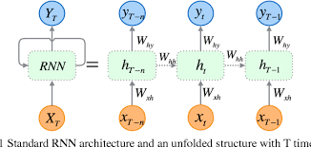
1st Approach: RNN
Model Architecture:
LSTM Layer: 12 memory cells with 0.1 input dropout and 0.1 recurrent dropout.
Dense Layer (FC): 6 units for capturing complex relationships.
Output Layer: Single unit for continuous regression prediction.
Model Training Configuration:
Loss Function: Mean Squared Error (MSE).
Optimizer: RMSProp.
Early Stopping: Monitored on Validation Loss, patience=10, restores best weights.
EXPLAINABILITY
Interpretation Challenge:
LSTM's internal workings make it challenging to interpret.
Lack of transparency in the black-box nature of LSTM.
Feature Capture:
LSTM captures sequential dependencies over the defined window.
Memory cells retain information over time.
Prediction Rationale:
Output influenced by complex relationships learned in the FC layer.
Influenced by historical patterns within the window.

Slide 8
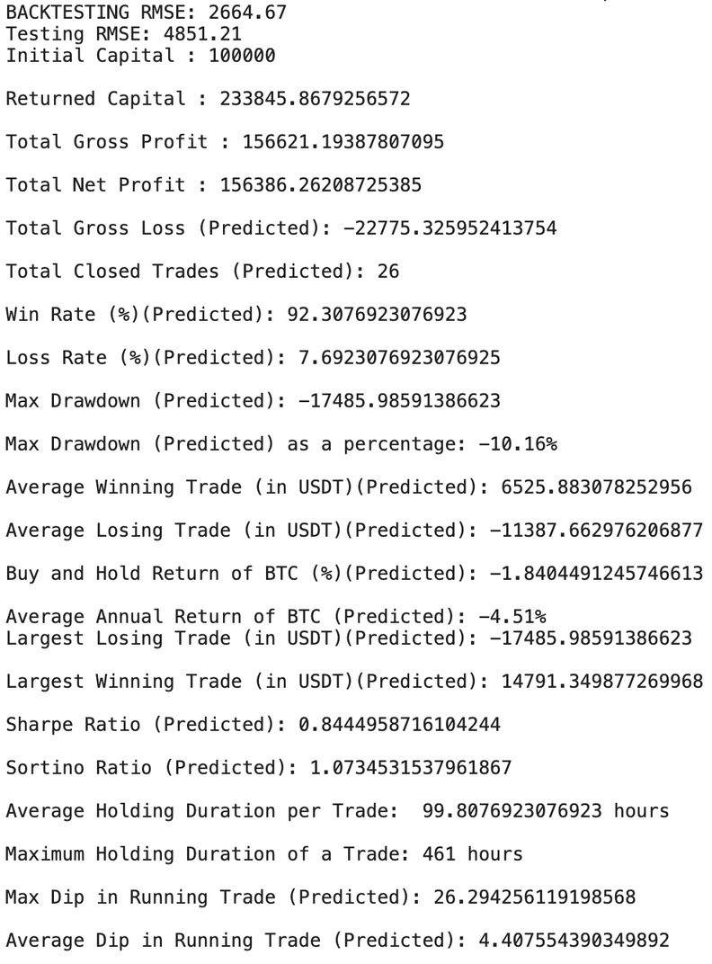
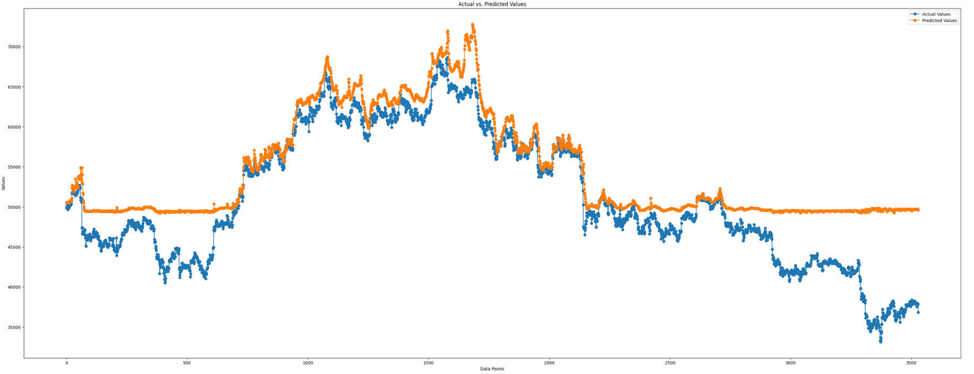
1st Approach: RNN
IN-SAMPLE TESTING

Slide 9
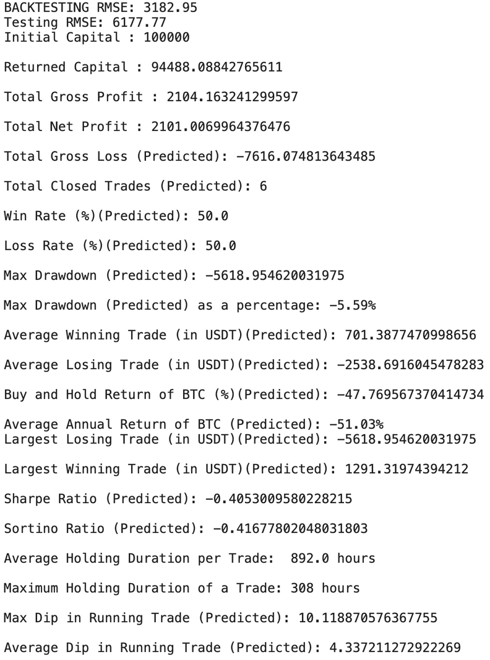
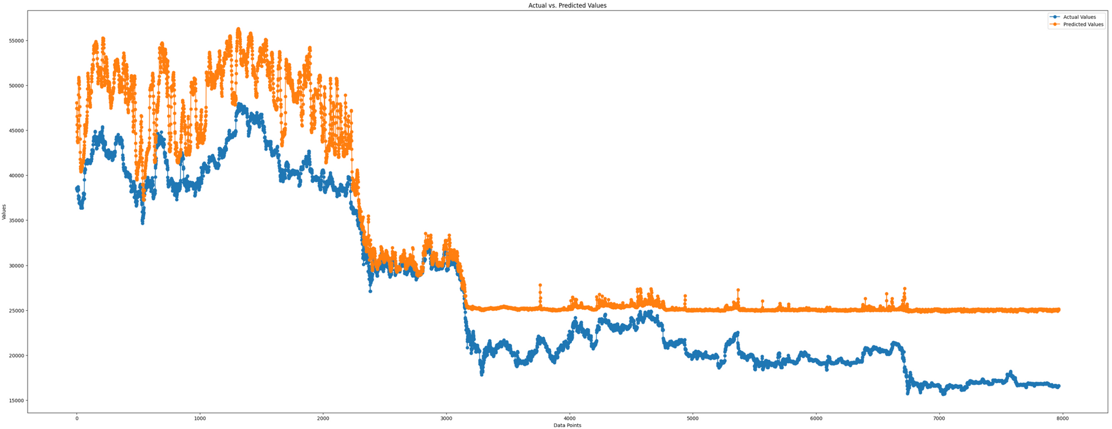
1st Approach: RNN
OUT_OF_SAMPLE_I_TESTING

Slide 10
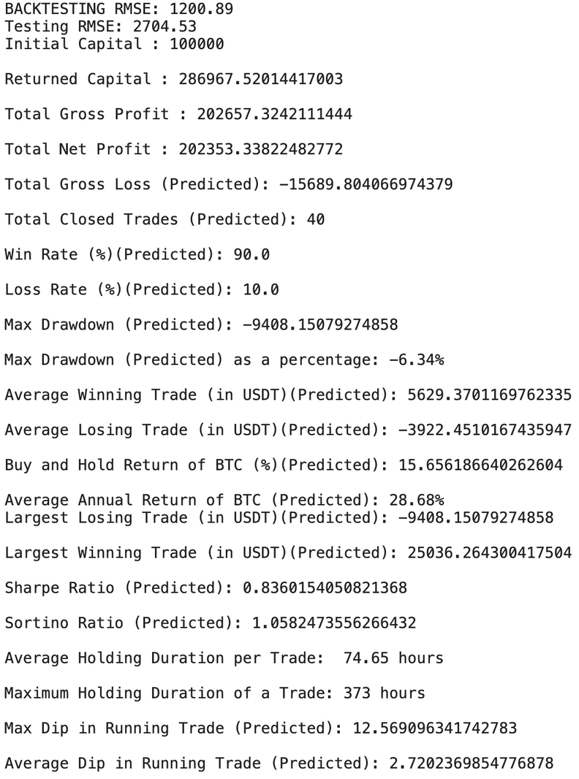
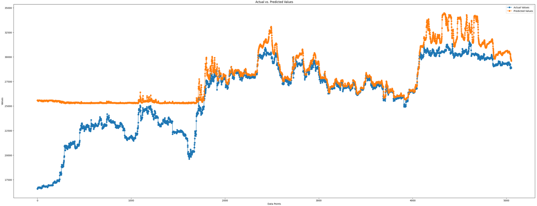
1st Approach: RNN
OUT_OF_SAMPLE_II_TESTING

Slide 11
2nd Approach: LSTM
Model Architecture
Sequential Model:
Linear stack of layers for structured flow of information.
LSTM Layers (Temporal Modeling):
First Layer (64 units, ReLU) captures intricate temporal patterns (returns sequences).
Second Layer (32 units, ReLU) processes obtained sequences.
Dropout Layer (Overfitting Mitigation):
Dropout layer (0.2 rate) strategically placed to prevent overfitting during training.
Dense Layer (Output Prediction):
Final Dense layer for prediction based on processed information.
Total Parameters: 31,393.

Slide 12
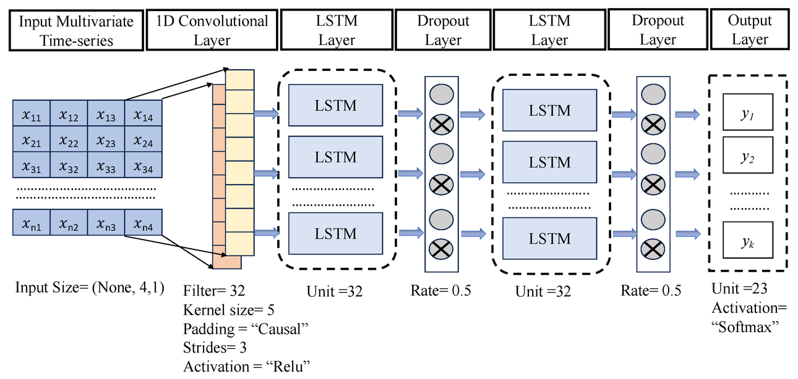
2nd Approach: LSTM
Model Training & Explainability
Training Configuration:
Optimizer: Adam
Loss Function: Mean Squared Error (MSE)
Explainability:
LSTM Layers for capturing long-term dependencies.
Dropout for regularization.
Model summary for architecture details.
Pros:
Effective temporal modeling with LSTMs.
Dropout for overfitting prevention.
Sequential structure for simplicity.
Cons:
Computational intensity of LSTM.
Hyperparameter sensitivity.
Limited context for very long-term dependencies.

Slide 13
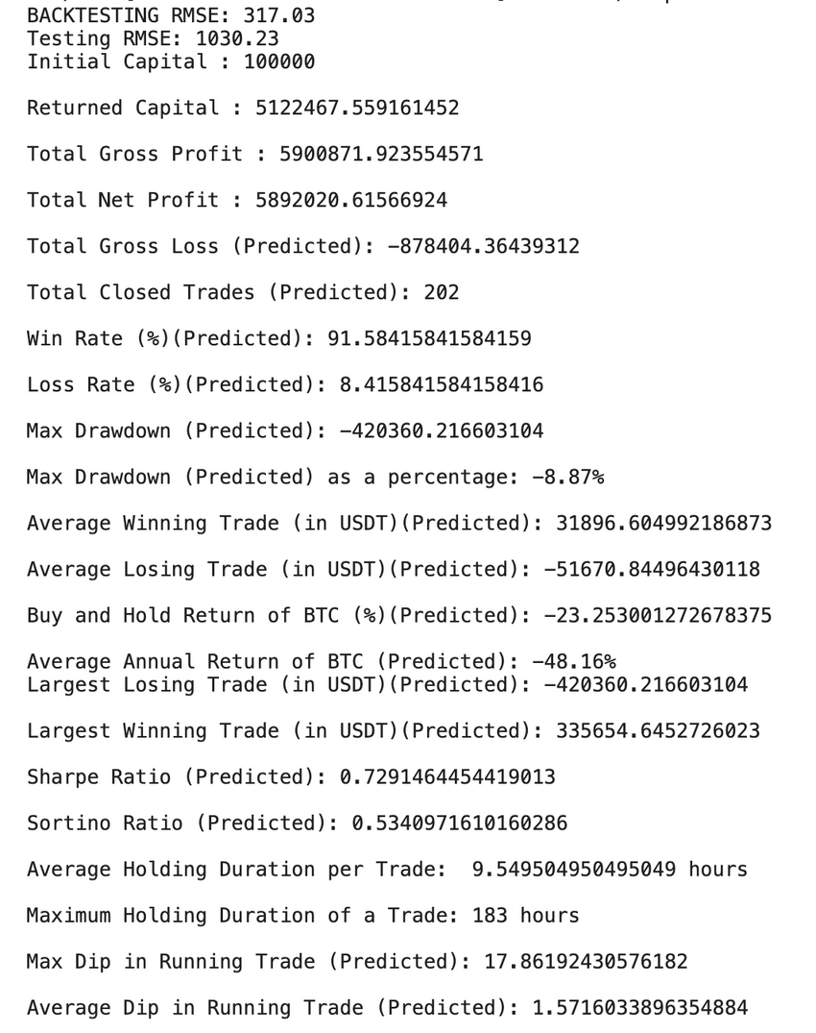
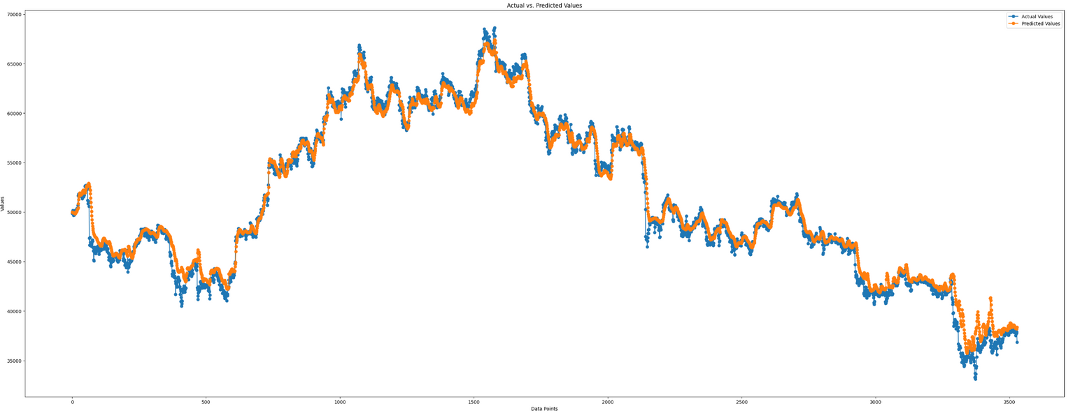
2nd Approach: LSTM
IN-SAMPLE TESTING

Slide 14
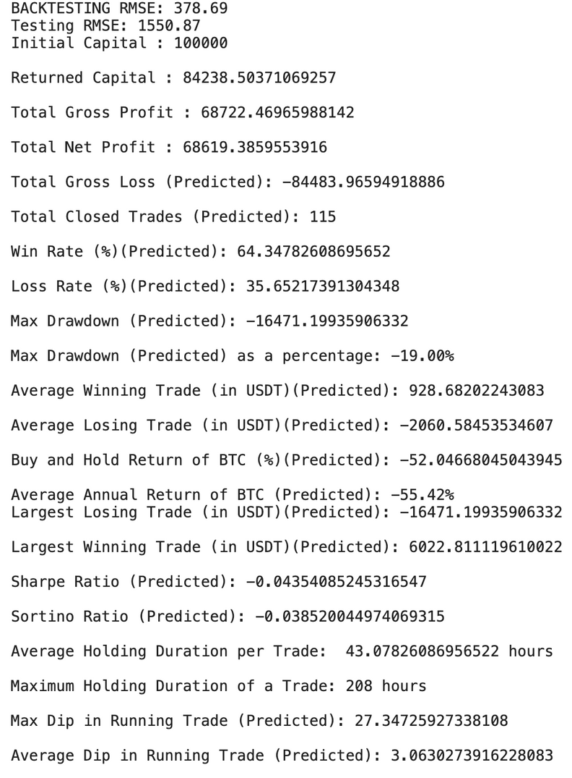
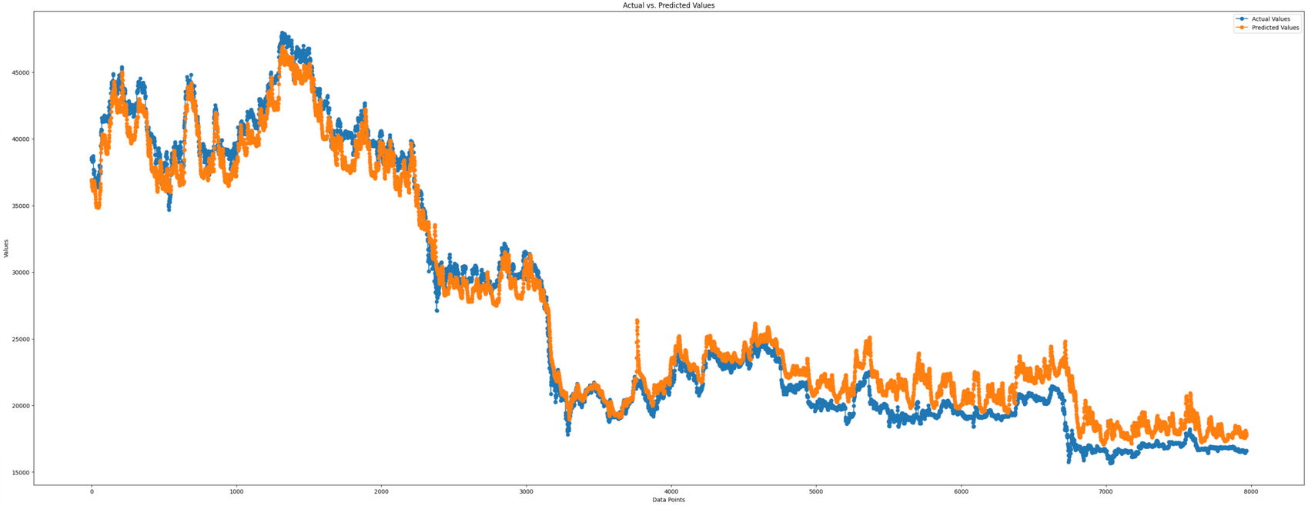
2nd Approach: LSTM
OUT_OF_SAMPLE_I_TESTING

Slide 15
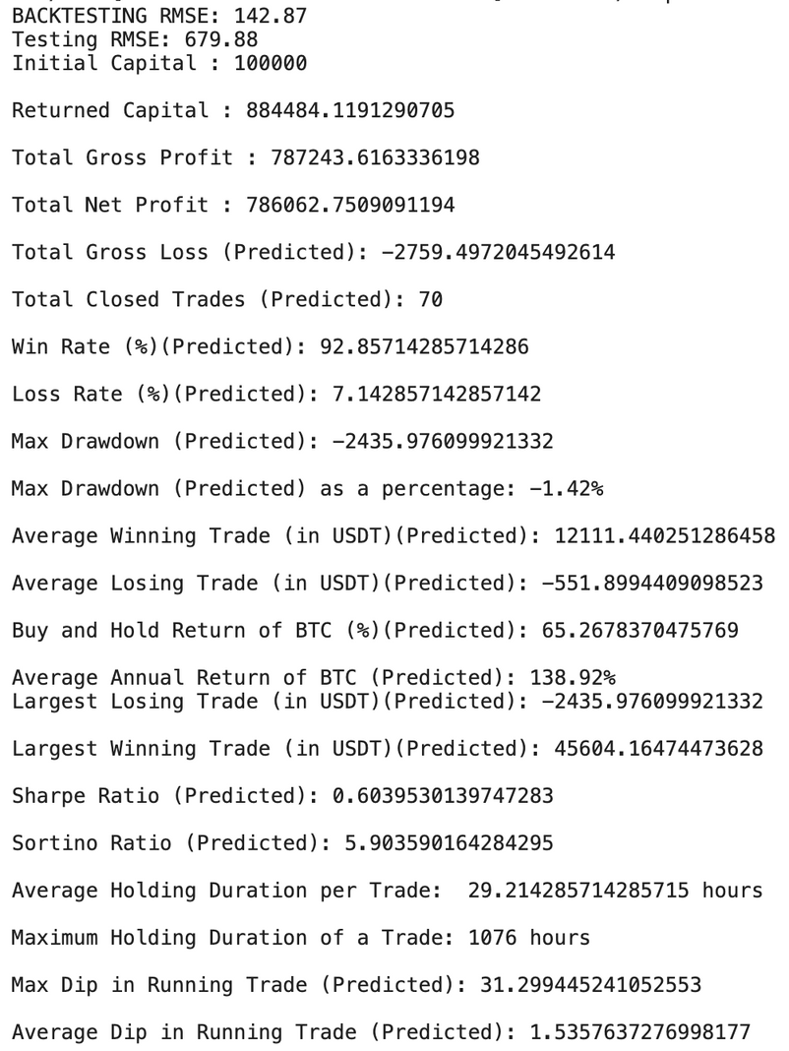
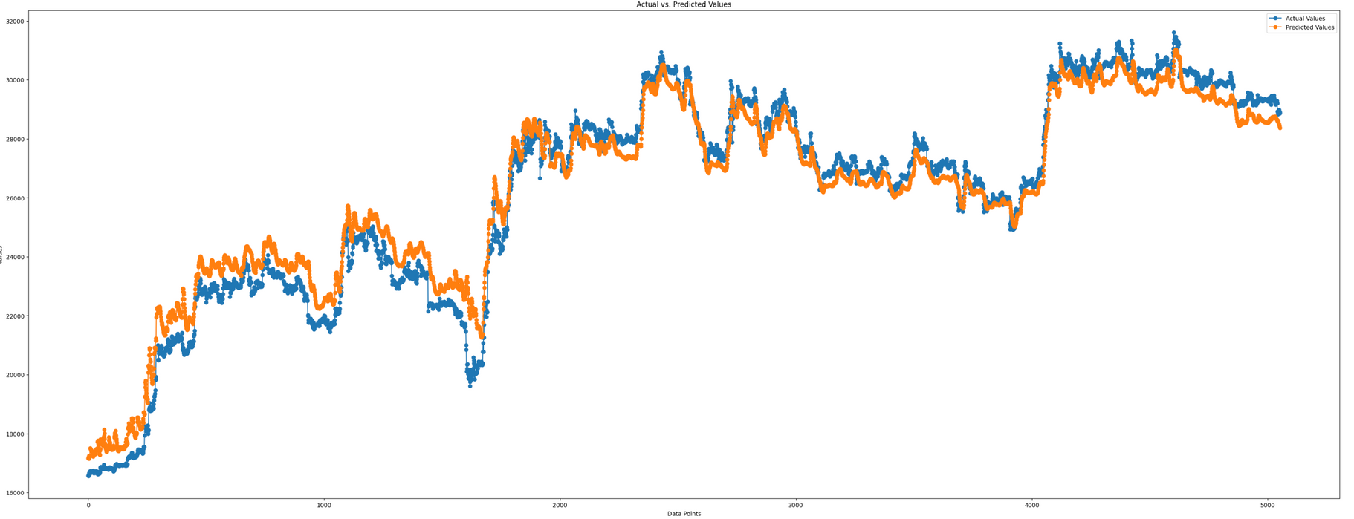
2nd Approach: LSTM
OUT_OF_SAMPLE_II_TESTING

Slide 16

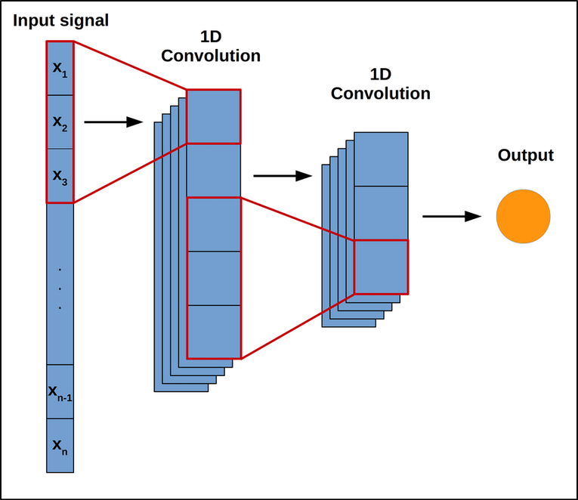
3rd Approach: Conv LSTM
Model Architecture:
Conv1D Layer:
64 filters, kernel_size=1, input_shape=(time_steps, features).
LSTM Layer:
50 units, ReLU activation.
Dense Layer:
1 neuron for regression.
Training Configuration:
Optimizer: Adam
Loss Function: MSE
Metrics: MAE, MSE
Epochs: 15
Batch Size: 8
Validation Split: 10%
Callbacks: Learning rate reduction
Explainability:
Conv1D: Captures local patterns.
LSTM: Processes sequential information.
Dense Layer: Produces final output.
Pros and Cons:
Pros:
Effective for capturing local and temporal patterns.
Adaptive learning rates with Adam.
Configurable for regression tasks.
Cons:
Computational complexity.
Requires careful hyperparameter tuning.
Limited context for very long-term dependencies.

Slide 17
3rd Approach: Conv LSTM
Enhancing BTC Prediction with ConvLSTM
In BTC prediction, while LSTMs excel at capturing temporal dependencies, their struggle with spatial patterns limits accuracy.
Transitioning to ConvLSTM, leveraging convolutional operations and filters, addresses these limitations.
This enhances feature extraction, allowing simultaneous capture of temporal and spatial dependencies for more accurate and adaptable BTC price predictions.
The move signifies a commitment to refining models based on the unique characteristics of cryptocurrency market dynamics.

Slide 18
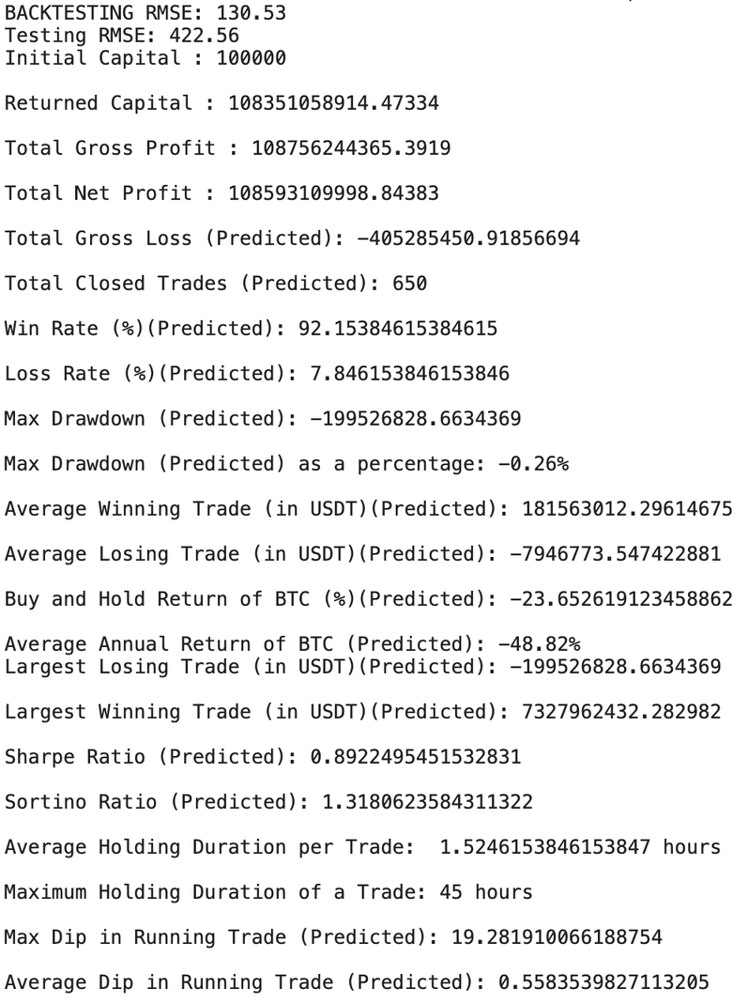
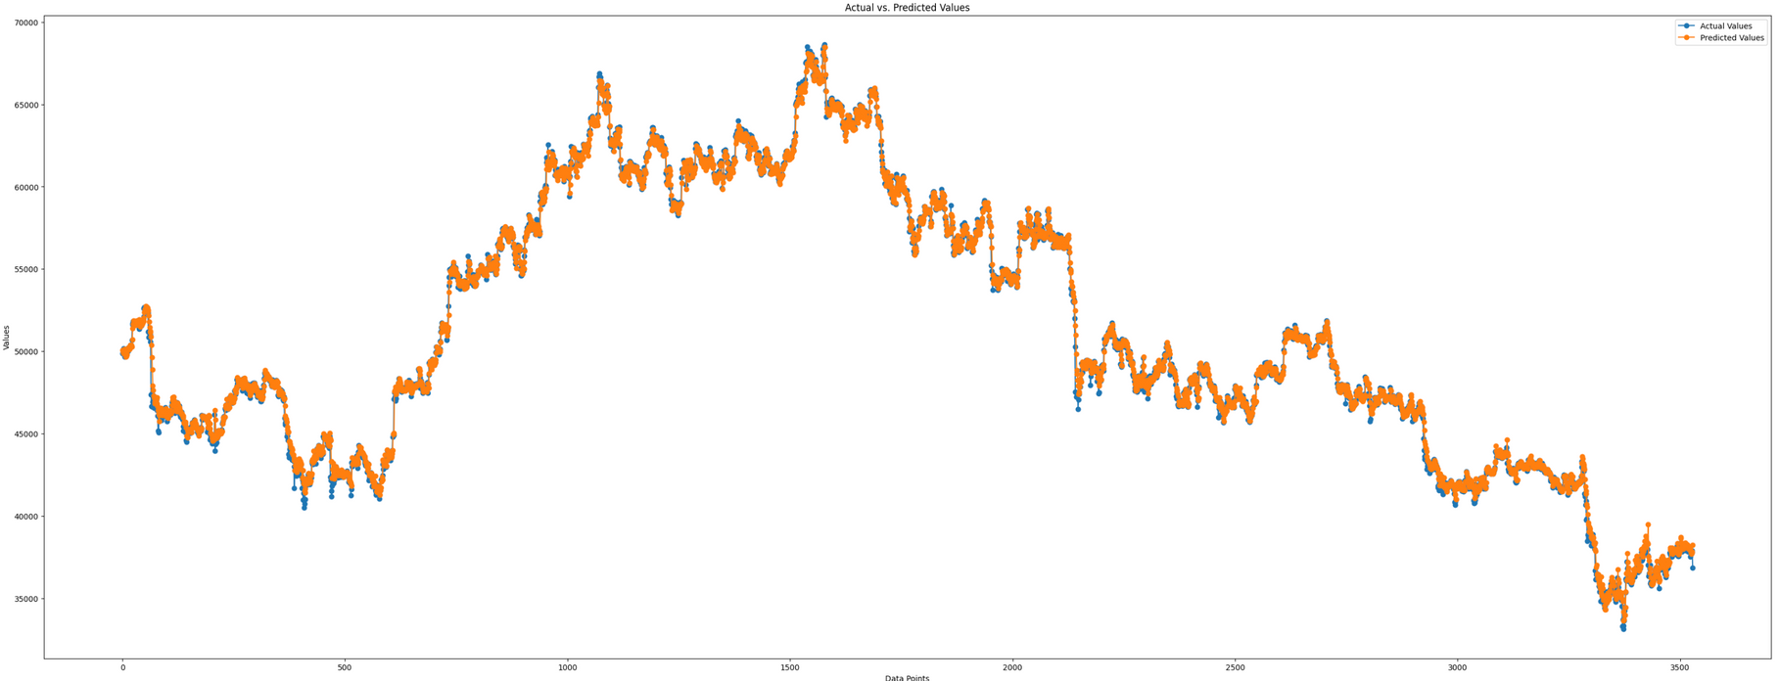
3rd Approach: Conv LSTM
IN-SAMPLE TESTING

Slide 19
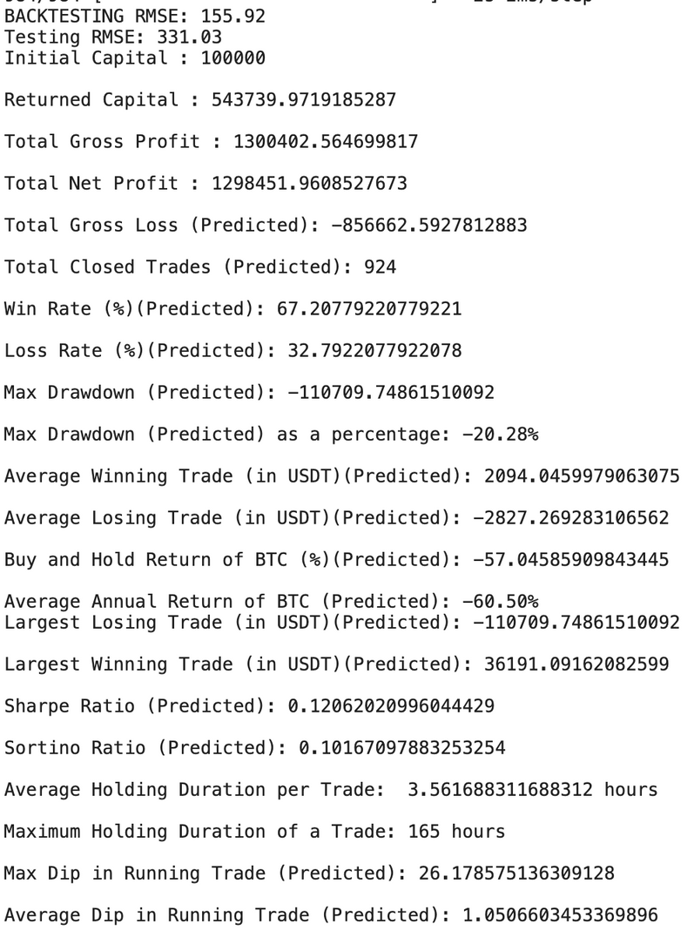
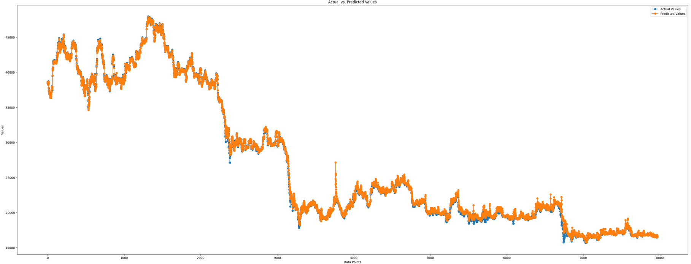
3rd Approach: Conv LSTM
OUT_OF_SAMPLE_I_TESTING

Slide 20
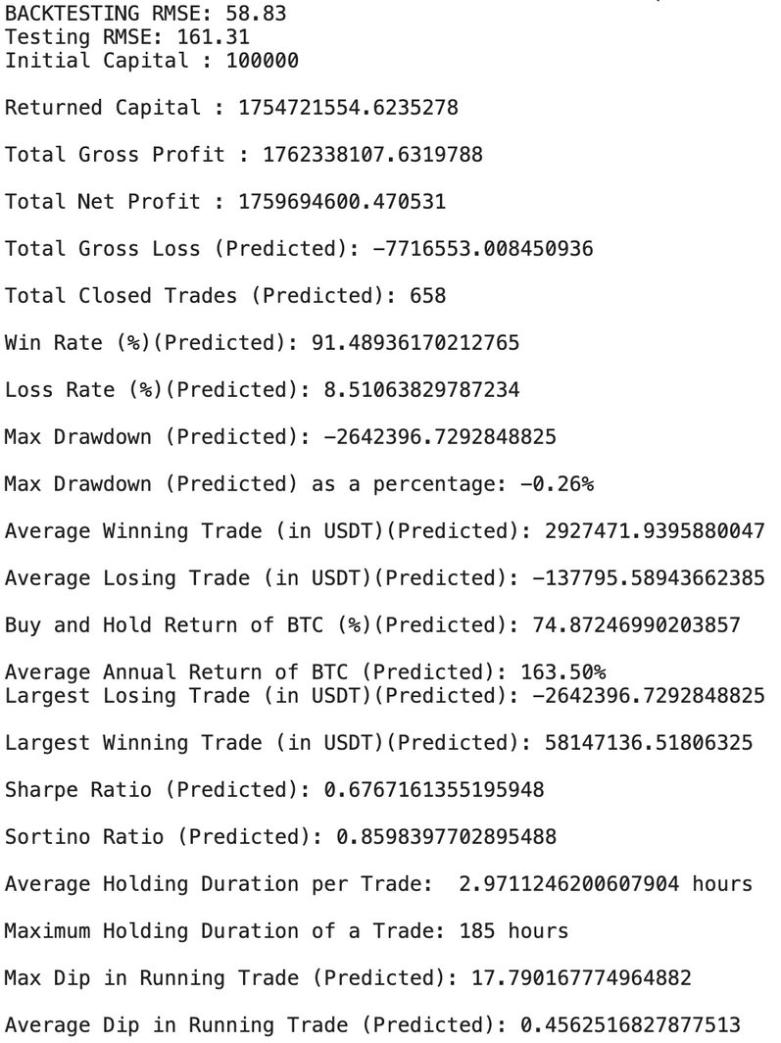
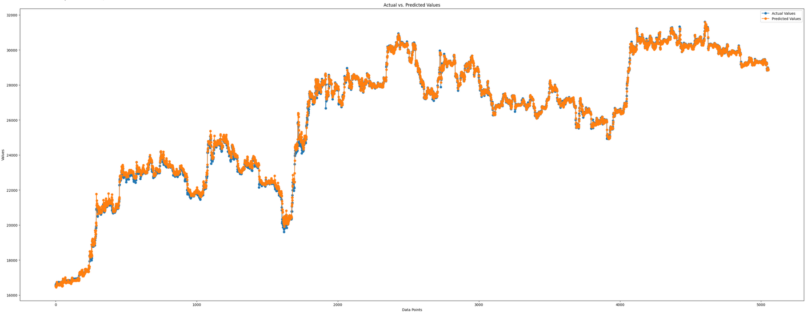
3rd Approach: Conv LSTM
OUT_OF_SAMPLE_II_TESTING

Slide 21
Risk Management
Integrated Risk Management & Performance Evaluation
1. Context:
BTC/USDT market demands robust risk management.
Commitment to balance risk and return for adaptive strategies.
2. Risk Management:
Diversification for risk spread.
Position size limits for capital control.
Tactical stop-loss rules aligned with BTC/USDT market volatility.
3. Backtesting & Metrics:
Comprehensive backtesting of risk strategies.
Sharpe and Sortino ratios gauge risk-adjusted returns.
4. Performance Metrics:
Sharpe Ratio: Comprehensive risk-adjusted returns.
Sortino Ratio: Focus on downside risk and adjustments.
5. Experimental Findings:
Diversification Resilience: Mitigation during turbulent phases.
Optimized Stop-Loss Rules: Balance between limiting losses and premature exits.
Enhanced Risk-Adjusted Returns: Improved performance reflected in heightened Sharpe ratios.
6. Adaptive Adjustments:
Real-time adaptability for ongoing performance assessments.
Crucial for navigating dynamic cryptocurrency markets.
Conclusion: Continuous pursuit of excellence in algorithmic trading methodologies, ensuring optimal risk-adjusted returns in the ever-evolving landscape of cryptocurrency trading.

Slide 22
Optimisation
Hyperparameter Optimization for BTC Price Prediction Models
1. Model Overview:
Relying on advanced deep learning models: RNN, LSTM, ConvLSTM.
Utilizing sequential dependencies in historical Bitcoin price data for accurate predictions.
2. Hyperparameter Optimization:
Backtesting: Thorough evaluation of model performance using historical data.
Performance Metrics: Comprehensive metrics, including accuracy, precision, recall, ROI, and drawdown.
Search Techniques: Rigorous grid search and random search for optimal hyperparameter configurations.
Cross-Validation: Implementation to ensure model robustness and prevent overfitting.
Validation Set: Dedicated set for assessing adaptability to new market conditions.
3. Experimental Findings:
Optimal Configurations: Identified hyperparameter settings for superior performance.
Performance Improvements: Significant enhancements in predictive accuracy and financial metrics.
Generalization: Robust generalization capabilities on unseen data and diverse market conditions.
Conclusion:
Ongoing pursuit of excellence in BTC price prediction through systematic hyperparameter optimization.
Improved models demonstrate superior performance, ensuring enhanced returns while effectively managing risk.

Slide 23
References
Deep learning models for price forecasting of financial time series: A review of recent advancements: 2020-2022: https://arxiv.org/pdf/2305.04811.pdf
Convolutional LSTM Network: A Machine Learning Approach for Precipitation Nowcasting: https://arxiv.org/pdf/1506.04214v2.pdf
A LSTM-Method for Bitcoin Price Prediction: A Case Study Yahoo Finance Stock Market: https://rie.binadarma.ac.id/file/conference/a-lstm-method-for-bitcoin-price-prediction-a-case-study-yahoo-finance-stock-market-1639027986.pdf
Bitcoin Price Prediction Using LSTM: https://www.irjet.net/archives/V9/i4/IRJET-V9I425.pdf

Slide 24
Thank You!

